Slide 1
Dynamic Programming
Dynamic Programming is a general algorithm design technique
for solving problems defined by recurrences with overlapping
subproblems
Invented by American mathematician Richard Bellman in the 1950s to solve optimization problems and later assimilated by CS
“Programming” here means “planning”
Main idea:
set up a recurrence relating a solution to a larger instance to solutions of some smaller instances
- solve smaller instances once
record solutions in a table
extract solution to the initial instance from that table
A. Levitin “Introduction to the Design & Analysis of Algorithms,” 3rd ed., Ch. 8 ©2012 Pearson Education, Inc. Upper Saddle River, NJ. All Rights Reserved.
‹#›
Notes:
‹#›

Slide 2
Example 1: Fibonacci numbers
Recall definition of Fibonacci numbers:
F(n) = F(n-1) + F(n-2)
F(0) = 0
F(1) = 1
Computing the n^{th} Fibonacci number recursively (top-down):
F(n)
F(n-1) + F(n-2)
F(n-2) + F(n-3) F(n-3) + F(n-4)
...
A. Levitin “Introduction to the Design & Analysis of Algorithms,” 3rd ed., Ch. 8 ©2012 Pearson Education, Inc. Upper Saddle River, NJ. All Rights Reserved.
‹#›
Notes:
‹#›

Slide 3
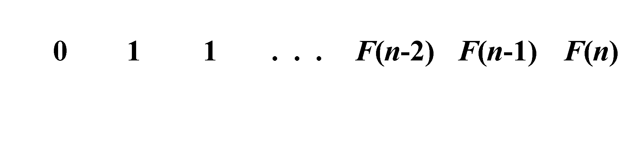
Example 1: Fibonacci numbers (cont.)
Computing the n^{th} Fibonacci number using bottom-up iteration and recording results:
F(0) = 0
F(1) = 1
F(2) = 1+0 = 1
…
F(n-2) =
F(n-1) =
F(n) = F(n-1) + F(n-2)
Efficiency:
- time
- space
A. Levitin “Introduction to the Design & Analysis of Algorithms,” 3rd ed., Ch. 8 ©2012 Pearson Education, Inc. Upper Saddle River, NJ. All Rights Reserved.
‹#›
Notes:
‹#›

Slide 4
Example 2: Coin-row problem
There is a row of n coins whose values are some positive integers c₁, c₂,...,c_{n}, not necessarily distinct. The goal is to pick up the maximum amount of money subject to the constraint that no two coins adjacent in the initial row can be picked up.
E.g.: 5, 1, 2, 10, 6, 2. What is the best selection?
Also try: 5, 1, 6, 10, 5, 2
A. Levitin “Introduction to the Design & Analysis of Algorithms,” 3rd ed., Ch. 8 ©2012 Pearson Education, Inc. Upper Saddle River, NJ. All Rights Reserved.
‹#›

Slide 5
DP solution to the coin-row problem
Let F(n) = maximum amount that can be picked up from the first n coins in the row of coins.
To derive a recurrence for F(n), we partition all the allowed coin selections into two groups: those without last coin – the max amount is ? those with the last coin -- the max amount is ? Thus we have the following recurrence F(n) = max{ } for n > 1,
F(0) = 0, F(1)=c₁
A. Levitin “Introduction to the Design & Analysis of Algorithms,” 3rd ed., Ch. 8 ©2012 Pearson Education, Inc. Upper Saddle River, NJ. All Rights Reserved.
‹#›

Slide 6
DP solution to the coin-row problem
Let F(n) = maximum amount that can be picked up from the first n coins in the row of coins.
To derive a recurrence for F(n), we partition all the allowed coin selections into two groups: those without last coin – the max amount is ? those with the last coin -- the max amount is ? Thus we have the following recurrence F(n) = max{c_{n} + F(n-2), F(n-1)} for n > 1,
F(0) = 0, F(1)=c₁
A. Levitin “Introduction to the Design & Analysis of Algorithms,” 3rd ed., Ch. 8 ©2012 Pearson Education, Inc. Upper Saddle River, NJ. All Rights Reserved.
‹#›

Slide 7
DP solution to the coin-row problem (cont.)
F(n) = max{c_{n} + F(n-2), F(n-1)} for n > 1,
F(0) = 0, F(1)=c₁
index | 0 | 1 | 2 | 3 | 4 | 5 | 6
coins | -- | 5 | 1 | 6 | 10 | 5 | 2
F( ) | 0, N | 5 Y | 5 N | 11 Y | 15 Y | 16 Y | 17 Y
Max amount: Coins of optimal solution: Time and space efficiency:
What’s missing? …
Note: All smaller instances were solved. Solution to subproblem may not be part of solution to larger problem. (Greedy algorithms don’t solve all smaller and always use solution to smaller in larger.)
A. Levitin “Introduction to the Design & Analysis of Algorithms,” 3rd ed., Ch. 8 ©2012 Pearson Education, Inc. Upper Saddle River, NJ. All Rights Reserved.
‹#›

Slide 8
DP solution to the coin-row problem (cont.)
F(n) = max{c_{n} + F(n-2), F(n-1)} for n > 1,
F(0) = 0, F(1)=c₁
index | 0 | 1 | 2 | 3 | 4 | 5 | 6
coins | -- | 5 | 1 | 6 | 10 | 5 | 2
F( )
Max amount: Coins of optimal solution: Time and space efficiency:
What’s missing? Which coins to pick up! Any ideas?
Note: All smaller instances were solved. Solution to subproblem may not be part of solution to larger problem. (Greedy algorithms don’t solve all smaller and always use solution to smaller in larger.)
A. Levitin “Introduction to the Design & Analysis of Algorithms,” 3rd ed., Ch. 8 ©2012 Pearson Education, Inc. Upper Saddle River, NJ. All Rights Reserved.
‹#›

Slide 9
DP solution to the coin-row problem (cont.)
F(n) = max{c_{n} + F(n-2), F(n-1)} for n > 1,
F(0) = 0, F(1)=c₁
i | 0 | 1 | 2 | 3 | 4 | 5 | 6
c(i) | -- | 5 | 1 | 6 | 10 | 5 | 2
F( i) | 0 | 5 | 5 | 11 | 15 | 16 | 17
To find coins, remember choice at each step:
1. Add row P(n): 0/1 = leave/pickup coin n (at that point)
2. Fill in rows F and P together, left to right
3. For final choice, work backwards from right:
0=leave and move 1 left, 1=pickup and move 2 left
A. Levitin “Introduction to the Design & Analysis of Algorithms,” 3rd ed., Ch. 8 ©2012 Pearson Education, Inc. Upper Saddle River, NJ. All Rights Reserved.
‹#›

Slide 10
DP solution to the coin-row problem (cont.)
F(n) = max{c_{n} + F(n-2), F(n-1)} for n > 1,
F(0) = 0, F(1)=c₁
i | 0 | 1 | 2 | 3 | 4 | 5 | 6
c(i) | -- | 5 | 1 | 6 | 10 | 5 | 2
F(i) | 0 | 5 | 5 | 11 | 15 | 16 | 17
Choice |  | 1 | 0 | 1 | 1 | 1 | 1
Pick |  | 1 |  |  | 1 |  | 1
A. Levitin “Introduction to the Design & Analysis of Algorithms,” 3rd ed., Ch. 8 ©2012 Pearson Education, Inc. Upper Saddle River, NJ. All Rights Reserved.
‹#›

Slide 11
DP Steps
F(n) = max{c_{n} + F(n-2), F(n-1)} for n > 1,
F(0) = 0, F(1)=c₁
Recursive math function describing maximum
Recursive function solving problem, top down (too slow)
Iterative solution, bottom up
Add information to find how to get maximum
Work backward to find maximum
A. Levitin “Introduction to the Design & Analysis of Algorithms,” 3rd ed., Ch. 8 ©2012 Pearson Education, Inc. Upper Saddle River, NJ. All Rights Reserved.
‹#›

Slide 12
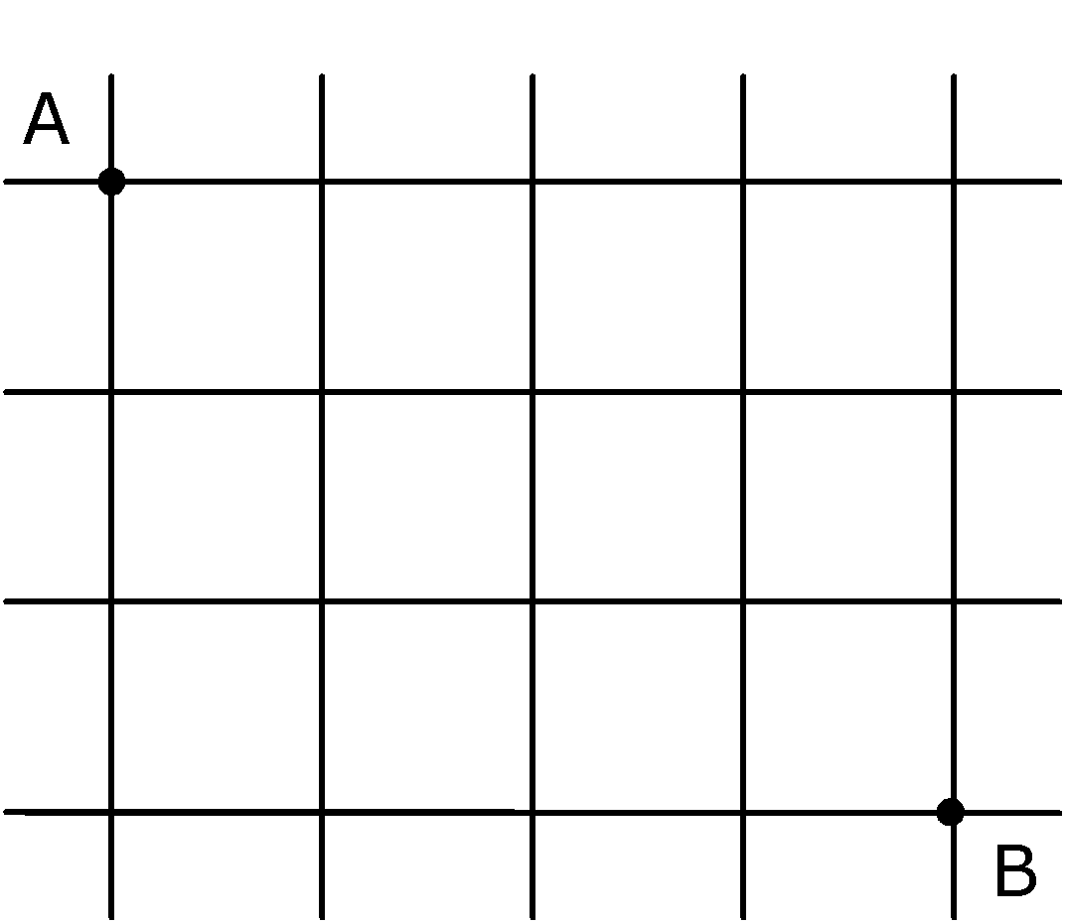
Example 3: Path counting
Consider the problem of counting the number of shortest paths from point A to point B in a city with perfectly horizontal streets and vertical avenues
F(i,j)=
F(i-1,j) + F(I, j-1)
A. Levitin “Introduction to the Design & Analysis of Algorithms,” 3rd ed., Ch. 8 ©2012 Pearson Education, Inc. Upper Saddle River, NJ. All Rights Reserved.
‹#›

Slide 13
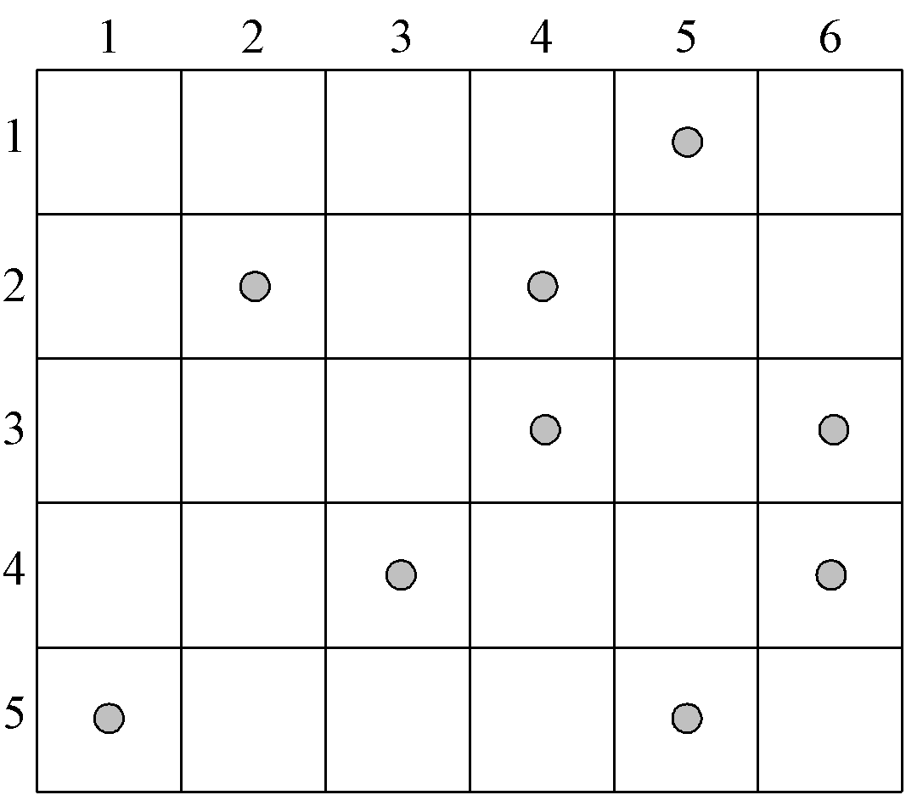
Example 4: Coin-collecting by robot
Several coins are placed in cells of an n×m board. A robot, located in the upper left cell of the board, needs to collect as many of the coins as possible and bring them to the bottom right cell. On each step, the robot can move either one cell to the right or one cell down from its current location.
A. Levitin “Introduction to the Design & Analysis of Algorithms,” 3rd ed., Ch. 8 ©2012 Pearson Education, Inc. Upper Saddle River, NJ. All Rights Reserved.
‹#›

Slide 14
Solution to the coin-collecting problem
Let F(i,j) be the largest number of coins the robot can collect and bring to cell (i,j) in the ith row and jth column.
The largest number of coins that can be brought to cell (i,j): from the left neighbor ?
from the neighbor above?
The recurrence:
F(i, j) = max{F(i-1, j), F(i, j-1)} + c_{ij} for 1 ≤ i ≤ n, 1 ≤ j ≤ m
where c_{ij} = 1 if there is a coin in cell (i,j), and c_{ij} = 0 otherwise
F(0, j) = 0 for 1 ≤ j ≤ m and F(i, 0) = 0 for 1 ≤ i ≤ n.
A. Levitin “Introduction to the Design & Analysis of Algorithms,” 3rd ed., Ch. 8 ©2012 Pearson Education, Inc. Upper Saddle River, NJ. All Rights Reserved.
‹#›

Slide 15
Solution to the coin-collecting problem (cont.)
F(i, j) = max{F(i-1, j), F(i, j-1)} + c_{ij} for 1 ≤ i ≤ n, 1 ≤ j ≤ m
where c_{ij} = 1 if there is a coin in cell (i,j), and c_{ij} = 0 otherwise
F(0, j) = 0 for 1 ≤ j ≤ m and F(i, 0) = 0 for 1 ≤ i ≤ n.
A. Levitin “Introduction to the Design & Analysis of Algorithms,” 3rd ed., Ch. 8 ©2012 Pearson Education, Inc. Upper Saddle River, NJ. All Rights Reserved.
‹#›

Slide 16
Solution to coin-collecting problem (cont.)
F(i, j) = max{F(i-1, j), F(i, j-1)} + c_{ij} for 1 ≤ i ≤ n, 1 ≤ j ≤ m
where c_{ij} = 1 if there is a coin in cell (i,j), and c_{ij} = 0 otherwise
F(0, j) = 0 for 1 ≤ j ≤ m and F(i, 0) = 0 for 1 ≤ i ≤ n.
Code (3 versions)? Storage? Path? Storage? Subproblems?
A. Levitin “Introduction to the Design & Analysis of Algorithms,” 3rd ed., Ch. 8 ©2012 Pearson Education, Inc. Upper Saddle River, NJ. All Rights Reserved.
‹#›

Slide 17
Other examples of DP algorithms
Computing a binomial coefficient (# 9, Exercises 8.1)
General case of the change making problem (Sec. 8.1)
Some difficult discrete optimization problems:
- knapsack (Sec. 8.2)
- traveling salesman
Constructing an optimal binary search tree (Sec. 8.3)
Warshall’s algorithm for transitive closure (Sec. 8.4)
Floyd’s algorithm for all-pairs shortest paths (Sec. 8.4)
A. Levitin “Introduction to the Design & Analysis of Algorithms,” 3rd ed., Ch. 8 ©2012 Pearson Education, Inc. Upper Saddle River, NJ. All Rights Reserved.
‹#›
Notes:
‹#›

Slide 18
Knapsack Problem by DP
Given n items of
integer weights: w₁ w₂ … w_{n}
values: v₁ v₂ … v_{n}
a knapsack of integer capacity W
find most valuable subset of the items that fit into the knapsack
Recursive solution?
What is smaller problem?
How to use solution to smaller in solution to larger Table?
Order to solve?
Initial conditions?
A. Levitin “Introduction to the Design & Analysis of Algorithms,” 3rd ed., Ch. 8 ©2012 Pearson Education, Inc. Upper Saddle River, NJ. All Rights Reserved.
‹#›
Notes:
‹#›

Slide 19
Knapsack Problem by DP (example)
Example: Knapsack of capacity W = 5
item weight value
1 2 $12
2 1 $10
3 3 $20
4 2 $15 capacity j
0 1 2 3 4 5
0 0 0 0 0 0 0
w₁ = 2, v₁= 12 1 0 0
w₂ = 1, v₂= 10 2
w₃ = 3, v₃= 20 3
w₄ = 2, v₄= 15 4 ?
A. Levitin “Introduction to the Design & Analysis of Algorithms,” 3rd ed., Ch. 8 ©2012 Pearson Education, Inc. Upper Saddle River, NJ. All Rights Reserved.
‹#›
Notes:
‹#›

Slide 20
Knapsack Problem by DP (example)
Example: Knapsack of capacity W = 5
item weight value
1 2 $12
2 1 $10
3 3 $20
4 2 $15 capacity j
0 1 2 3 4 5
0 0 0 0 0 0 0
w₁ = 2, v₁= 12 1 0 0 12 12 12 12
w₂ = 1, v₂= 10 2 0 10 12 22 22 22
w₃ = 3, v₃= 20 3 0 10 12 22 30 32
w₄ = 2, v₄= 15 4 0 10 15 25 30 37 ?
A. Levitin “Introduction to the Design & Analysis of Algorithms,” 3rd ed., Ch. 8 ©2012 Pearson Education, Inc. Upper Saddle River, NJ. All Rights Reserved.
‹#›
Notes:
‹#›

Slide 21
Knapsack Problem by DP
Given n items of
integer weights: w₁ w₂ … w_{n}
values: v₁ v₂ … v_{n}
a knapsack of integer capacity W
find most valuable subset of the items that fit into the knapsack
Recursive solution?
What is smaller problem?
How to use solution to smaller in solution to larger Table?
Order to solve?
Initial conditions?
A. Levitin “Introduction to the Design & Analysis of Algorithms,” 3rd ed., Ch. 8 ©2012 Pearson Education, Inc. Upper Saddle River, NJ. All Rights Reserved.
‹#›
Notes:
‹#›

Slide 22
Knapsack Problem by DP
Given n items of
integer weights: w₁ w₂ … w_{n}
values: v₁ v₂ … v_{n}
a knapsack of integer capacity W
find most valuable subset of the items that fit into the knapsack
Consider instance defined by first i items and capacity j (j ≤ W).
Let V[i,j] be optimal value of such instance. Then
max {V[i-1,j], v_{i} + V[i-1,j- w_{i}]} if j- w_{i} ≥ 0
V[i,j] =
V[i-1,j] if j- w_{i} < 0
Initial conditions: V[0,j] = 0 and V[i,0] = 0
A. Levitin “Introduction to the Design & Analysis of Algorithms,” 3rd ed., Ch. 8 ©2012 Pearson Education, Inc. Upper Saddle River, NJ. All Rights Reserved.
‹#›
Notes:
‹#›

Slide 23
Optimal Binary Search Trees
Problem: Given n keys a₁ < …< a_{n} and probabilities p₁ ≤ … ≤ p_{n} searching for them, find a BST with a minimum average number of comparisons in successful search.
Since total number of BSTs with n nodes is given by C(2n,n)/(n+1), which grows exponentially, brute force is hopeless.
Example: What is an optimal BST for keys A, B, C, and D with search probabilities 0.1, 0.2, 0.4, and 0.3, respectively?
What smaller problems could we use?
Let’s first look at an example.
A. Levitin “Introduction to the Design & Analysis of Algorithms,” 3rd ed., Ch. 8 ©2012 Pearson Education, Inc. Upper Saddle River, NJ. All Rights Reserved.
‹#›
Notes:
‹#›

Slide 24

Expected number of comparisons?
Example: key A B C D
probability 0.1 0.2 0.4 0.3
C
B
D
optimal BST
A
Notes:
‹#›

Slide 25
Expected number of comparisons for optimal BST: 1*0.4 + 2*(0.2+0.3) + 3*(0.1) = 0.4+1.0+0.3=1.7 Non-optimal BST – Swap A and B: 1*0.4 + 2*(0.1+0.3) + 3*(0.2) = 0.4+0.8+0.6=1.8
Example: key A B C D
probability 0.1 0.2 0.4 0.3
C
B
D
optimal BST
A
Notes:
‹#›

Slide 26
Expected number of comparisons for optimal BST: 1*0.4 + 2*(0.2+0.3) + 3*(0.1) = 0.4+1.0+0.3=1.7 Can factor out cost of visiting each node once: 1*0.4 + 2*(0.2+0.3) + 3*(0.1) = 0*.4+1*.5+2*.1 + 1*(.4+.5+.1) Moving subtree up or down changes total by weight of subtree - BA at level 1/2 has cost 1*.2 + 2*.1 = .4 = - BA at level 2/3 has cost 2*.2 + 3*.1 = .7 = .4 + (.2 + .1) - BA at level 3/4 has cost ???
Example: key A B C D
probability 0.1 0.2 0.4 0.3
C
B
D
optimal BST
A
Notes:
‹#›

Slide 27
Expected number of comparisons for optimal BST: 1*0.4 + 2*(0.2+0.3) + 3*(0.1) = 0.4+1.0+0.3=1.7 Can factor out cost of visiting each node once: 1*0.4 + 2*(0.2+0.3) + 3*(0.1) = 0*.4+1*.5+2*.1 + 1*(.4+.5+.1) Moving subtree up or down changes total by weight of subtree - BA at level 1/2 has cost 1*.2 + 2*.1 = 0.4 = - BA at level 2/3 has cost 2*.2 + 3*.1 = 0.7 = .4 + (.2 + .1) - BA at level 3/4 has cost 3*.2 + 4*.1 = 1.0 = .4 + (.2 + .1)
Example: key A B C D
probability 0.1 0.2 0.4 0.3
C
B
D
optimal BST
A
Notes:
‹#›

Slide 28
Optimal Binary Search Trees
Problem: Given n keys a₁ < …< a_{n} and probabilities p₁ ≤ … ≤ p_{n} searching for them, find a BST with a minimum average number of comparisons in successful search.
What smaller problems could we use?
A. Levitin “Introduction to the Design & Analysis of Algorithms,” 3rd ed., Ch. 8 ©2012 Pearson Education, Inc. Upper Saddle River, NJ. All Rights Reserved.
‹#›
Notes:
‹#›

Slide 29
Optimal Binary Search Trees
Problem: Given n keys a₁ < …< a_{n} and probabilities p₁ ≤ … ≤ p_{n} searching for them, find a BST with a minimum average number of comparisons in successful search.
What smaller problems could we use?
What if we let each element be the root?
What is needed then?
A. Levitin “Introduction to the Design & Analysis of Algorithms,” 3rd ed., Ch. 8 ©2012 Pearson Education, Inc. Upper Saddle River, NJ. All Rights Reserved.
‹#›
Notes:
‹#›

Slide 30
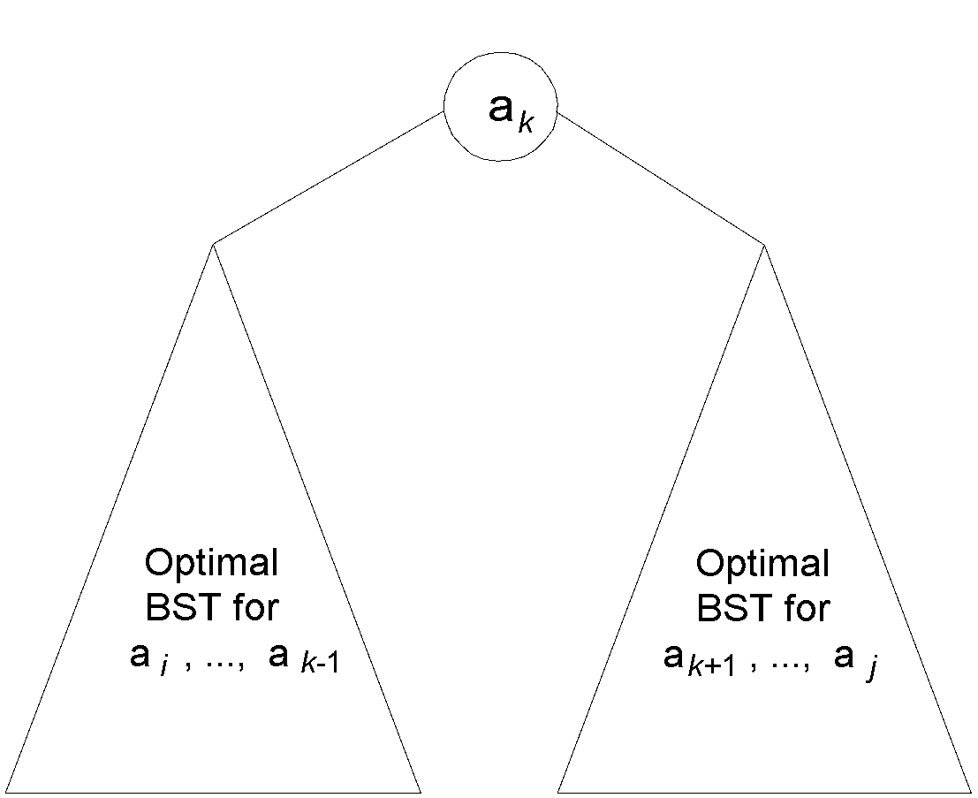
DP for Optimal BST Problem
Let T[i,j] be optimal BST for keys a_{i} < …< a_{j} , C[i,j] be minimum average number of comparisons made in T[i,j], for 1 ≤ i ≤ j ≤ n. Consider optimal BST among all BSTs with some a_{k} (i ≤ k ≤ j ) as their root; T[i,j] is the best among them.
Min Num Comparisons
C[i,j] =
min {p_{k} · 1 +
∑ p_{s} · (level a_{s} in T[i,k-1] +1) +
∑ p_{s} · (level a_{s} in T[k+1,j] +1)}
Best Tree
i ≤ k ≤ j
k-1
s = i
j
s =k+1
A. Levitin “Introduction to the Design & Analysis of Algorithms,” 3rd ed., Ch. 8 ©2012 Pearson Education, Inc. Upper Saddle River, NJ. All Rights Reserved.
‹#›
Notes:
‹#›

Slide 31
DP for Optimal BST Problem (cont.)
After simplifications, we obtain the recurrence for C[i,j]:
C[i,j] = min {C[i,k-1] + C[k+1,j]} + ∑ p_{s} for 1 ≤ i ≤ j ≤ n
C[i,i] = p_{i} for 1 ≤ i ≤ j ≤ n
What table elements are involved?
j
i ≤ k ≤ j
s = i
A. Levitin “Introduction to the Design & Analysis of Algorithms,” 3rd ed., Ch. 8 ©2012 Pearson Education, Inc. Upper Saddle River, NJ. All Rights Reserved.
‹#›
Notes:
‹#›

Slide 32
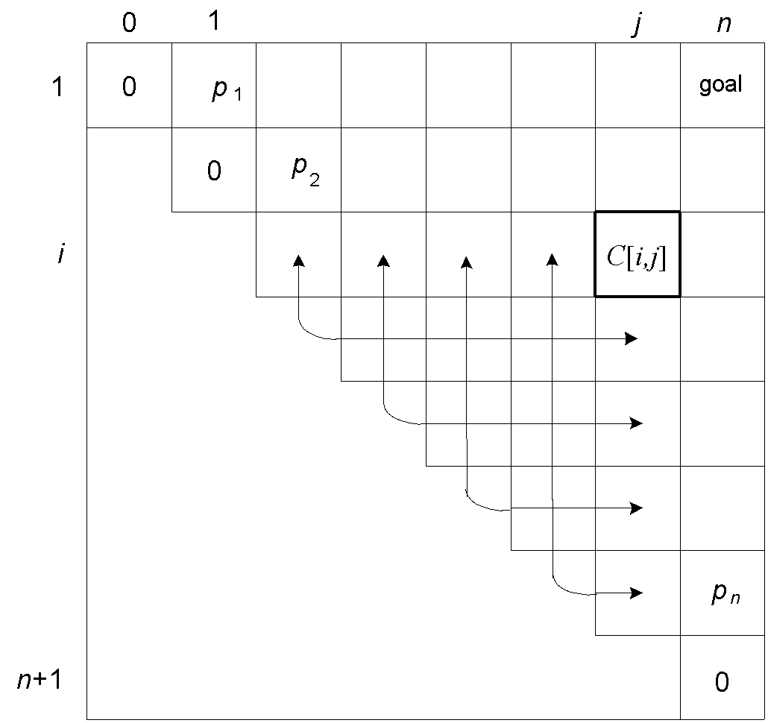
DP for Optimal BST Problem (cont.)
After simplifications, we obtain the recurrence for C[i,j]:
C[i,j] = min {C[i,k-1] + C[k+1,j]} + ∑ p_{s} for 1 ≤ i ≤ j ≤ n
C[i,i] = p_{i} for 1 ≤ i ≤ j ≤ n
j
i ≤ k ≤ j
s = i
A. Levitin “Introduction to the Design & Analysis of Algorithms,” 3rd ed., Ch. 8 ©2012 Pearson Education, Inc. Upper Saddle River, NJ. All Rights Reserved.
‹#›
Notes:
‹#›

Slide 33
Example: key A B C D
probability 0.1 0.2 0.4 0.3
The left table is filled using the recurrence
C[i,j] = min {C[i,k-1] + C[k+1,j]} + ∑ p_{s ,} C[i,i] = p_{i}
The right saves the tree roots, which are the k’s that give the minima
j
i ≤ k ≤ j
s = i
_{i} ^{j}
_{i} ^{j}
 | 0 | 1 | 2 | 3 | 4
1 | 0 | .1 | .4 | 1.1 | 1.7
2 |  | 0 | .2 | .8 | 1.4
3 |  |  | 0 | .4 | 1.0
4 |  |  |  | 0 | .3
5 |  |  |  |  | 0
 | 0 | 1 | 2 | 3 | 4
1 |  | 1 | 2 | 3 | 3
2 |  |  | 2 | 3 | 3
3 |  |  |  | 3 | 3
4 |  |  |  |  | 4
5
C
B
D
A
optimal BST
Tables filled diagonal by diagonal (remember what C[i,j] is).
Notes:
‹#›

Slide 34
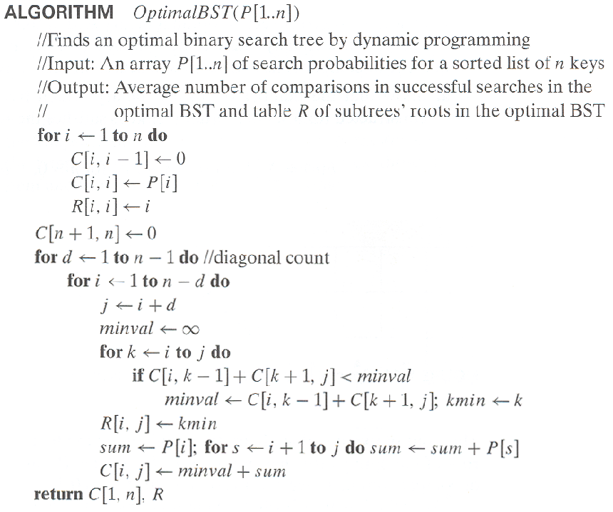
Optimal Binary Search Trees
A. Levitin “Introduction to the Design & Analysis of Algorithms,” 3rd ed., Ch. 8 ©2012 Pearson Education, Inc. Upper Saddle River, NJ. All Rights Reserved.
‹#›
Notes:
‹#›

Slide 35
Analysis DP for Optimal BST Problem
Time efficiency: Θ(n³) but can be reduced to Θ(n²) by taking advantage of monotonicity of entries in the root table, i.e., R[i,j] is always in the range between R[i,j-1] and R[i+1,j]
Space efficiency: Θ(n²)
Method can be expanded to include unsuccessful searches
A. Levitin “Introduction to the Design & Analysis of Algorithms,” 3rd ed., Ch. 8 ©2012 Pearson Education, Inc. Upper Saddle River, NJ. All Rights Reserved.
‹#›
Notes:
‹#›

